Slide 1
Individuals and Organizations
Sean Coulter - Xinyu Wang - Cody Rhee - Kyle Dukart - Mustafa Majeed

Slide 2
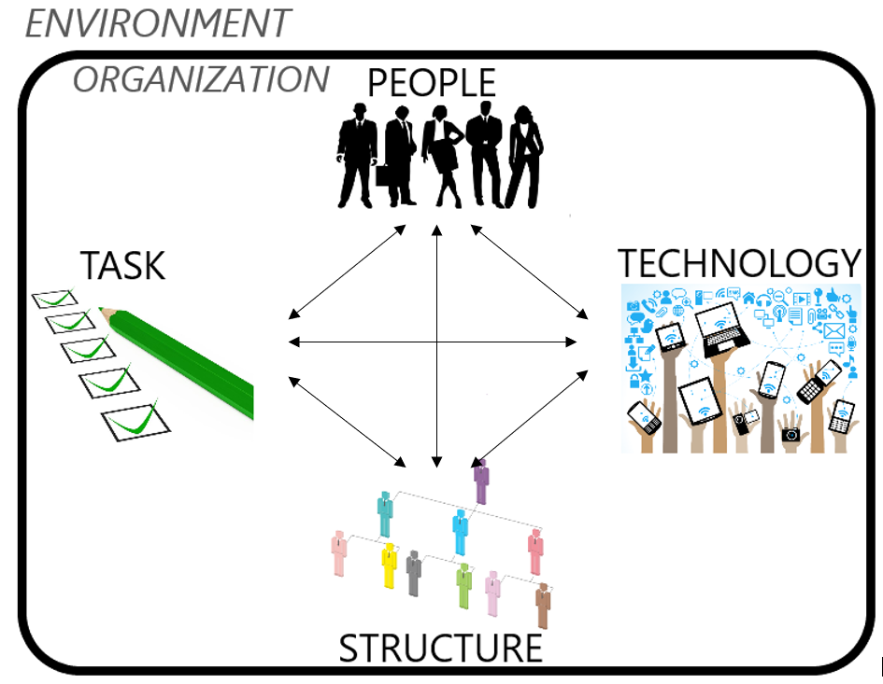
Leavitt’s Diamond
Four Components
People
Task (Company Goal)
Structure
Technology
Used for making organizational change more effective
Change in one component has direct effect on other components
Notes:
https://edisciplinas.usp.br/pluginfile.php/1769799/mod_resource/content/3/texto%2001%20-%20Leavitts%20Diamond%20-%20An%20Integrated%20Approach%20to%20Change.pdf
https://www.brighthubpm.com/change-management/122495-a-look-at-the-components-of-leavitts-diamond/

Slide 3
How Change Affects the Diamond
People
Task - Educate - Train
Structure - Duties - Responsibilities
Tech - Ability - Extra Training
Tasks
People - Modify to optimize
Structure - Pyramid - Flat
Tech - Expense - Better Product
Structure
People - Supervision - Trained Employees
Task - Customer Focused - New Dept
Tech - Communication - Dept
Technology
People - Skill growth - Additional Tasks
Task - Additional products/services
Structure - Shrink/Expand

Slide 4
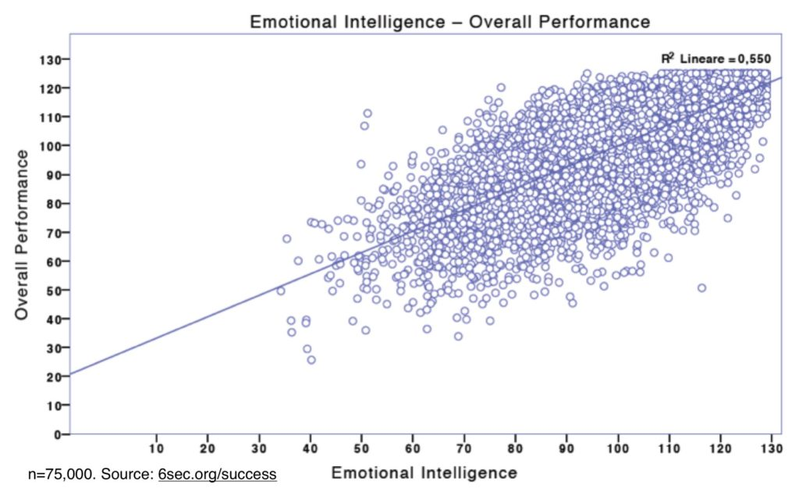
Emotional Intelligence-- why it’s important
New economy means new approach to business, changing workplace, new standards
Baby-boomer management, women in the workplace
A ‘better’ way to correlate high performance with certain characteristics
And therefore a means of quantifying good performance

Slide 5
How to Improve Our Emotional Intelligence
With ourselves (Intrapersonal competencies)
Increase self-awareness
Monitoring emotional state and recognize when it changes
Managing emotions
Count to ten Or “Meditation”
Motivating Ourselves
With others (Interpersonal competencies)
Relating well
Emotional mentoring

Slide 6

How is Technology Changing the Present Workplace?
Flexibility
Flexible hours
Easy access to work items
Easy Communication
Instant Messaging/Video Chats
Diverse coworkers
Continuous Learning
Learning new skills may be necessary
e.g. CodeAcademy

Slide 7
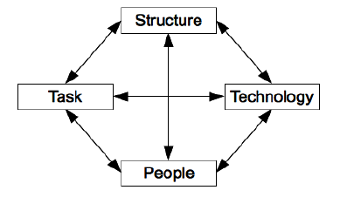
How Will Technology Change the Near Future?
Automation
Will change the nature of work, not destroy it
Natural Language Processing
Understand and replicate basic human speech
Amazon chatbot
Machine Learning
Systems improve from experience without
explicit programming
Could change the healthcare system

Slide 8
Q&A

Slide 9
Activity 1
Emotional Intelligence test-- give test (10)
http://www.sdcity.edu/portals/0/cms_editors/mesa/pdfs/emotionalintelligence.pdf
Take the test and break into groups based on score. Mark your totals. Split up 5 tables based on score with 8 people per table. One group representative per table.
DnD style Scenario game--test of personal emotional awareness, emotional management, social emotional management, and relationship management(15)

Slide 10
Emotional awareness
Discuss for 5 minutes and come up with solution.
You sit down at your desk in the morning and spill coffee on your lap while simultaneously dropping your breakfast sandwich on your keyboard. Mayonnaise spills into the gaps between keys and lunch isn’t for another 4 hours. Do you:
a. Ask your boss to move your lunch time sooner by explaining your situation.
b. Internalize your rage and clean up your mess and try to move on.
c. Something else

Slide 11
Emotional management:
Your coworker walks up to you and tries to continue a passionate argument that you had about your fantasy league in the middle of a meeting. Do you:
a. Attempt to ease the situation and transition back to work
b. Hold your ground and argue your point without sway
c. Something else

Slide 12
Social emotional awareness
You’re working on a system that was passed to you from a coworker. The system is full of code you’re having trouble understanding so you frequently go to your coworker to ask for clarification. You ask your coworker for help all the time. Do you:
a. Acknowledge the help you’re getting each time you ask for it.
b. Assume your coworker is OK with helping you and continue to go to them whenever you have a question.
c. Something else

Slide 13
Teamwork and Conflict
Lucy can not complete her report until John gets all of the numbers to her. Lucy believes that John procrastinates until the last minute, forcing her to do a rushed job which increases her stress and makes her fear that she will look bad to the boss. John feels like Lucy puts too much pressure on both of them, and sets unrealistic deadlines. As the conflict increases, the productivity and efficiency decrease. How do you as a manager resolve this conflict?
a. Reprimand John for procrastination.
b. Work with John and Lucy to find a deadline schedule that works for both of them.
c. Something else

Slide 14
Emotional Intelligence Conclusion
Despite your scores on the EI test, your group probably chose the “emotionally aware” answer. This shows 2 things: there is more than one way to quantify EI, and maybe you’re more emotionally intelligent than you thought!

Slide 15
Activity 2
Case study - Restaurant taking orders using automated system (10)

